Slide 1
Village Health & sanitation p. mehar srinivas T. sashank v. Bhargav m. uday shankar
A step to make village healthier

Slide 2
Contents:
Health and hygiene
Village level health and hygiene
Rural health care
Importance
Existing Solution
Achieving Health
Proper Diet
Water & water treatment
Seasonal diseases
Main diseases causing factors

Slide 3
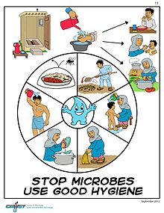
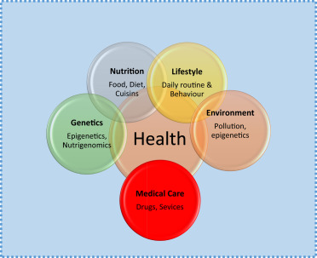
Health and Hygiene
According to the World Health Organization, Health is a state of complete physical, mental and social well-being and not merely the absence of disease and infirmity.
Hygiene is a practice related to lifestyle, cleanliness, health and medicine.

Slide 4
Village level health and hygiene
Most of the village people are illiterate
They don’t have proper awareness on health and hygiene
As more awareness programs are going on, but people are still not aware of some diseases caused due to lack of hygiene and sanitization

Slide 5
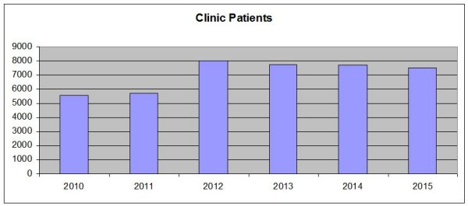
Rural Health care
According IRHS (Institute for Rural Health Studies) the graph shows us the no of rural area people approaching PHC’s

Slide 6
Importance
Health is the main important aspect for every human
Not only creating awareness, about health and hygiene but also educating people not to do unhealthy activities that cause diseases
The main theme of the project VILLAGE HEALTH is to create awareness among people using a different way of approach instead of traditional methods

Slide 7
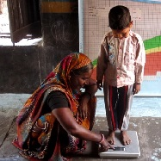
Existing solution
Rural Public Health Awareness and Assistance center
It is an initiative to undertake public healthcare through community based activities in our village based facilities

Slide 8
Achieving Good Health
Knowing the health issues caused due to environmental and biological changes.
Maintaining personal hygiene and taking care on health.
Being aware of any disease outbreak and taking the particular precautionary measures.

Slide 9

Proper Diet
Proper diet plan plays a major role in maintaining proper health.
Improper diet leads poor nutrition and may cause nutrition deficiency related problems.

Slide 10
Water
WATER SOURCES
Protected springs
Dug wells
Boreholes
Piped water
Rain water
Ponds, lakes, etc.,
Water is the main reason for life on earth.
Microbes also use water as a medium to spread diseases.
So water should be purified before using.
Water can be treated in many household methods

Slide 11
Household water treatment
The main household water treatment is Boiling.
Boiling removes 99 percent of the harmful disease causing microbes.
The other types of the household water treatment are – canvas filters, candle filters, disinfection, settling.

Slide 12
Seasonal Diseases
People get sick with changing in seasons as the shift in temperature causes viruses to flourish which then spread diseases.
Some disease causing microbes spread more in certain temperatures.
Here are some details collected from Pedapudi PHC about different health problems that cause illness by change in seasons.

Slide 13
Seasonal Disease Statistics -2019

Slide 14
Main disease causing factors
Stagnant water
Improper waste management
Unclean water usage
Poor nutrition
Improper hygiene and sanitation
Air pollution
Inhuman activities like smoking

Slide 15
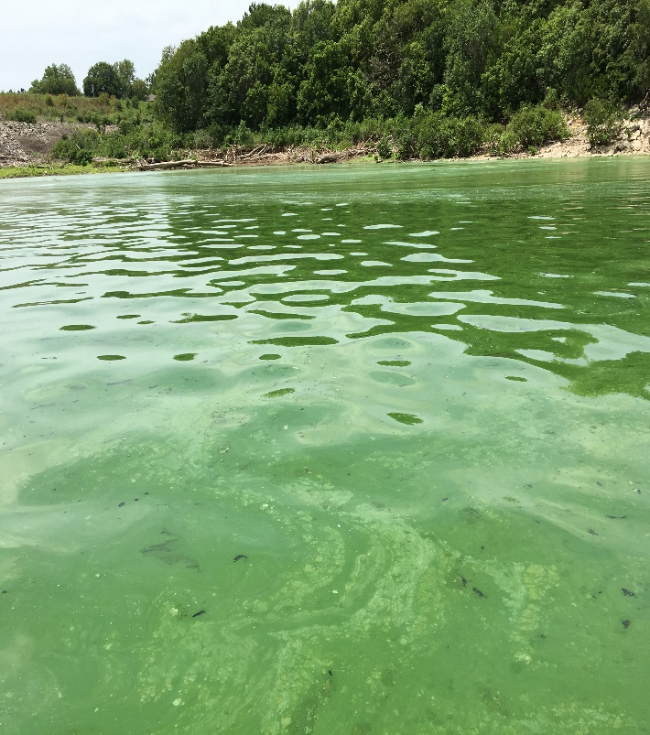
Stagnant water
Stagnant water can serve as a perfect ground for mosquitoes which transmit virus causing dengue, malaria, and other life threatening vector-borne diseases.
The selected village Pedapudi contains few lakes and ponds that hold stagnant water.
Locality nearby to those lakes is more effected by mosquitoes.

Slide 16
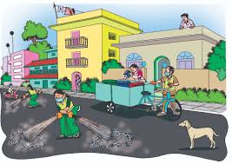
Waste management
Improper waste management may cause huge wastage dump and locality can be effected due to microbes in that waste.
In the village Pedapudi there is a waste management centre that collects all the dump and separate the waste into dry and wet waste, then that is treated accordingly.
In the village there are less problem due to waste management.

Slide 17

Unclean water
Unclean water causes severe damage to health.
Water should be treated accordingly before drinking that all the microbes present in the water should be dead.
In the village Pedapudi the water distributed throughout the village is purified and then distributed over the pipelines.

Slide 18
Poor nutrition and hygiene
Poor nutrition causes nutrition deficiency diseases.
Nutrition deficiency is mainly observed in the children in the village.
Proper hygiene makes the people more healthier.
Good hygiene maintenance and sanitation restricts the spread of diseases rapidly.

Slide 19
Air pollution
Air pollution mainly causes lungs related diseases
In the selected village the air is not polluted to cause severe diseases.
In the village the running of automobiles are less so air is not polluted more.
In addition to that the trees are more in number in the village, which help in purification of air.

Slide 20
Factors affecting health

Slide 21
Responsibilities of the village head
Gram panchayat should clean the stagnant water reserves regularly.
Should provide clean and purified drinking water.
Make sure that children and pregnant women getting sufficient nutrition through Anganwadi’s.
Should clean the village everyday to make a better hygienic environment.

Slide 22
Responsibilities of an individual
One should keep their surroundings clean and maintain a better hygiene.
Make sure that you eat only freshly prepared food to avoid food poisoning.
Intimate the panchayat about the unhealthy environment or unhygienic activites.

Slide 23


